Slide 1
Cyber Security in Infrastructure Protection
Alex Assante, Jasper Ladkin, Colt Bartnicki

Slide 2
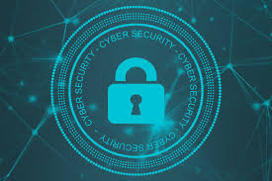
Cyber Security
Cyber security has become such a big part of our national security and is now a part of all of our military branches. Cyber security can be found all throughout both the public and private sector.
CISA, the Cybersecurity and Infrastructure Security Agency, defines cybersecurity as follows: Cybersecurity is the art of protecting networks, devices, and data from unauthorized access or criminal use and the practice of ensuring confidentiality, integrity, and availability of information.

Slide 3
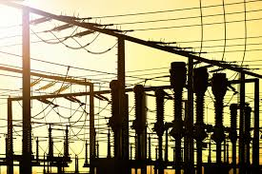
What is Critical Infrastructure?
Critical infrastructure is a term used by the government to describe essential assets for daily functioning of the economy and society.
Most people if asked what critical infrastructure is would only be able to name the power grid. While the power grid is important, arguably the most important, there are more critical infrastructure assets.

Slide 4
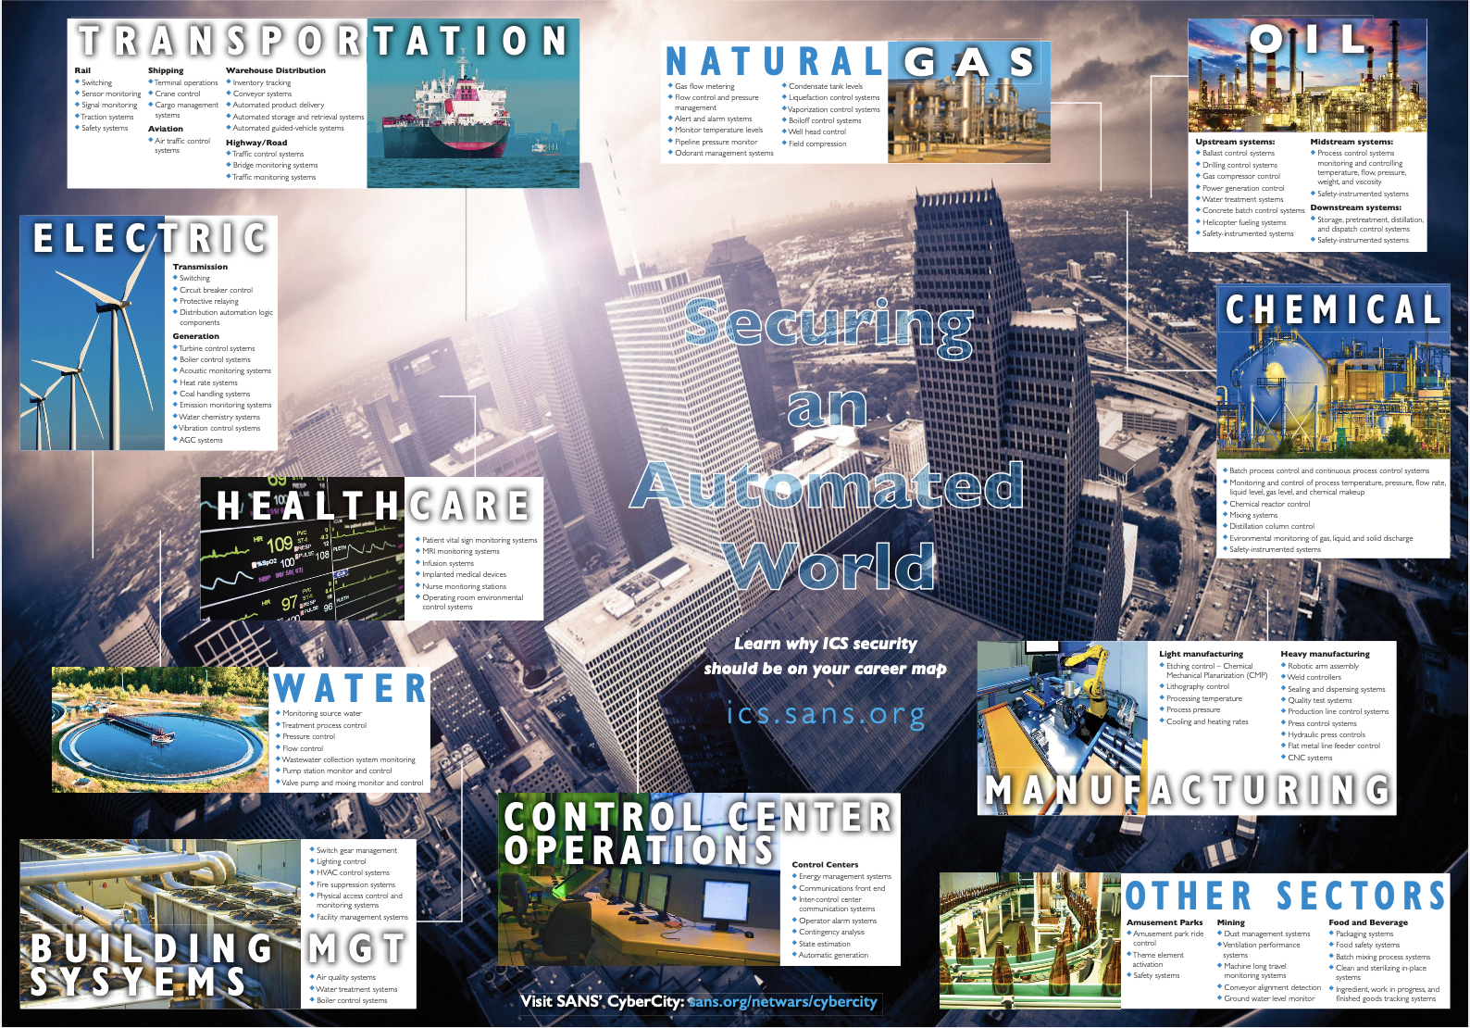

Slide 5
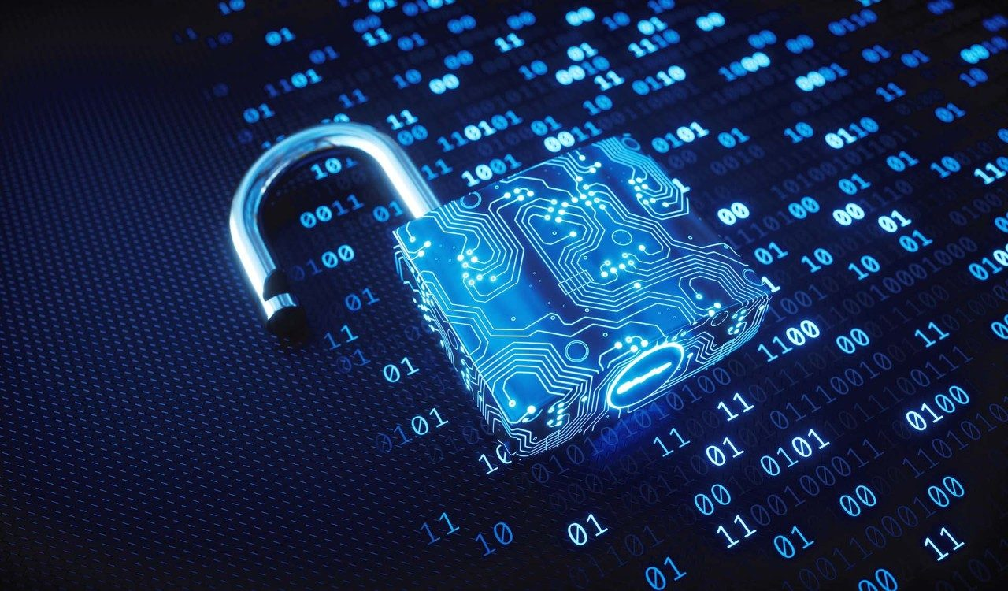
How do we protect our infrastructure?
We protect our critical infrastructure in multiple ways. Routine government mandated safety assessments. Policies that require state of the art security measures employed in critical infrastructure. A close relationship between the government and the private sector utilities in this field. And much more…….

Slide 6
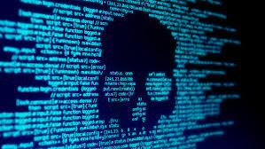
What threats does our infrastructure face?
Financial Gain (criminal act)
Encrypting data for ransom
Data Attack (criminal or Nation State attack)
Obtain / destroy crucial data
Nation State Attack
Physical impact (Critical facilities / loss of life)

Slide 7
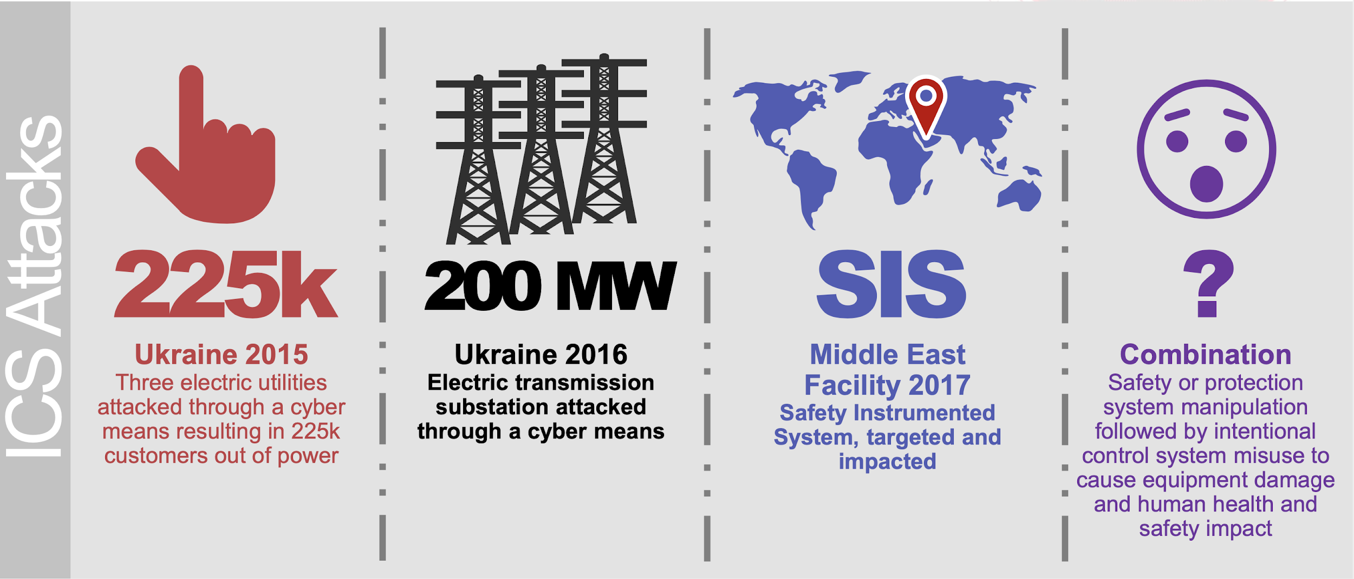

Slide 8
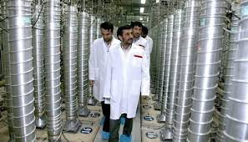
Stuxnet
An example of a military infrastructure attack would be Stuxnet. Stuxnet was a rootkit based worm that spread worldwide through Microsoft Windows computers after an initial USB infection. It scanned for Siemens software (industrial control software) and then infected systems looking for Iranian Nuclear Centrifuges.
It was made to cripple Iranian nuclear enrichment capabilities. The worm damaged nearly 2,000 centrifuges and even caused some centrifuges to explode. It achieved this by reporting normal traffic to monitoring devices and then speeding up and slowing down centrifuges till they broke.

Slide 9
Points of Attack/ Vulnerabilities
Stage 1 - Intrusion and Preparation through IT network
Spear Phishing/ Reconnaissance
Finding Exploits - unencrypted communications / protocols /easily corrupt control systems
Install Malware
Stage 2 - Development and execution on OT
Corrupt infrastructure components
Hide / Amplify attack

Slide 10
Exploiting Simple Systems
HVAC stands for Heating, Ventilation, and Air Conditioning.
Through these HVAC systems a hacker could access an isolated network that the systems are all connected through.
An HVAC attack has been theorized that some have the potential to cause a power surge and cripple a town’s power grid

Slide 11
Protection Layers
Vulnerability assessments (Stage 1 & stage 2)
Required/ Voluntary
Scope?
Quality of Pen testers
Implementing Regulation
Patching / updating protective software regularly
Regulation on venders

Slide 12
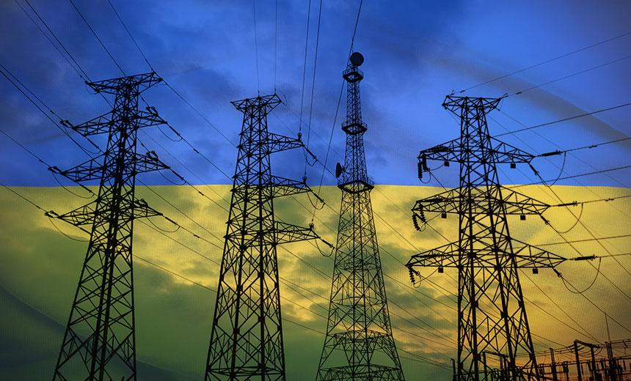
Ukraine - 2015/2016
Ukraine - In 2015, what is known as the first successful cyber attack happened on a Ukrainian power grid. Hackers were able to get into power grid systems of three areas and cripple them, cutting off power to a large part of Ukraine.

Slide 13
Conclusion/ Reflection
One thing to remember is it doesn’t matter who attacks our infrastructure when it happens, what does matter is that we are ready for the attack and if we aren’t then we fix the problem and improve our infrastructure.
It is essential that that we stay wary and protect our infrastructure against intrusion. By crippling our infrastructure, someone could cripple the nation. For example, most critical infrastructures can run on their own power for a week if something were to happen. If an attacker could take down our power grid, after a week we would be helpless and the nation would be crippled.

Slide 14
Something we want to leave you with…...
“From an adversary perspective, you’re not just stealing files, you’re getting into, understanding, and using a system to achieve your goal.”
Tim Conway, a leading cybersecurity expert with specialty in Critical Infrastructure Protection

Slide 15
References
Tim Conway - Security Professional specialization in Infrastructure protection
SANS.org - Private Company that Specializes in cybersecurity information
CISA- Cybersecurity & Infrastructure Security Agency (Department of Homeland Security)

